Slide 1
6 Types of Media Bias https://www.studentnewsdaily.com/types-of-media-bias/

Slide 2
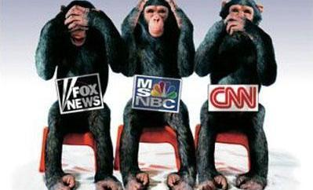


Slide 3
Bias by Omission
Leaving one side out of an article, or series of articles, over a period of time.
This can happen with one story, or a series of stories as a news outlet reports one set of events, not another.
Be aware of liberal and conservative perspectives on current events to find this type of bias.

Slide 4
Bias by Selection of Sources
Includes more sources that support one view over another.
This can be found when reporters use such phrases as “experts believe” or “observers say” or most people believe.”
Look for equal representation of both sides to find this type of bias.
Notes:
Two-Column Notes

Slide 5
Bias by Story Selection
A pattern of highlighting news stories that agree with the agenda of the left or right, and ignoring the other side.
To identify this bias, one needs to be aware of both the left and the rights perspective.

Slide 6
Bias by Placement
Story placement is a measure of how important the editor considers a story.
Many people only read the headlines, and therefore only see the larger stories.
To identify this type of bias, look for where a newspaper places political stories.

Slide 7
Bias by Labeling
There are two types of labeling- one in which one side of the political spectrum is given an extreme label, while the other side is not addressed with a label or given a more mild label.
The other type is when one side is given a label, and the other is identified as an “expert” or “independent group.”
When looking for this type of bias, remember labeling in and of itself is not bias. It is when one side is labeled and the other is not.

Slide 8
Bias by Spin
Spin occurs when a story only has one interpretation of an event or policy.
The reporter gives subjective comments about objective facts.
Making one ideological side look better than another.
To identify this type of bias, look for which perspective a news story matches- liberal or conservative.

Slide 9
Types of Bias Application!
Get a partner
With your partner, use your notes to determine what type of media bias is present and explain why for each scenario
We will go over these as a class when everyone is done

Slide 10
Political Spectrum
LIBERAL
MODERATE
CONSERVATIVE

Slide 11
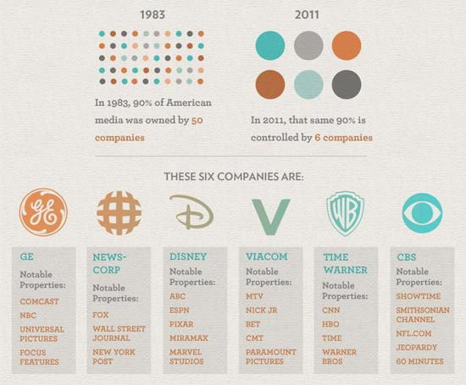

Slide 12
•Liberal-Political belief that a government exists to help, as well as protect, its people. Often tolerant of different views and standards of behavior.
•Conservative-Political belief that a government exist solely to protect a society. Desire to preserve the status quo, maintain traditional values, customs and avoid abrupt change.

Slide 13
Media Headlines
1. Go to FOX, MSNBC and CNN
2. Record 5 headlines per website dealing with Syria
3. What perspective do you believe each of these websites has on the issue of Syria?

Slide 14
Media bias about Syria
Liberal:
“Obama makes a crucial step”
“Iran releases human rights lawyer”
“Putin warns against US intervention”
“Jon Stewart destroys Fox News over Syria”
Conservative:
“blamed Clinton” (liberal politician)
“Obama aiding Assad”
“Obama starts to fade”
“The U.S. is exceptional”

Slide 15
Article Bias
Find an article from the internet about Syria from any source you would like and answer the following questions:
1. Write a brief description of the story. Include the 5 W’s!
2. What type(s) of media bias are present in this article? Use at least one example for each type of bias directly from the article to support your answer.
3. What is the source? Do you know anything about the traditional biases of that source?
4. What perspective does the article take on Syria? Use at least one example from the article to support your answer.
www.allsides.com

